Slide 1
Data Analysis Presentation
Employee Data Related to Attrition
Clem Mbote

Slide 2
Are there any trends in employee data that relates to attrition?
To answer this question, I exam three variables and how they relate to attrition
Age
Income
Distance to Work

Slide 3
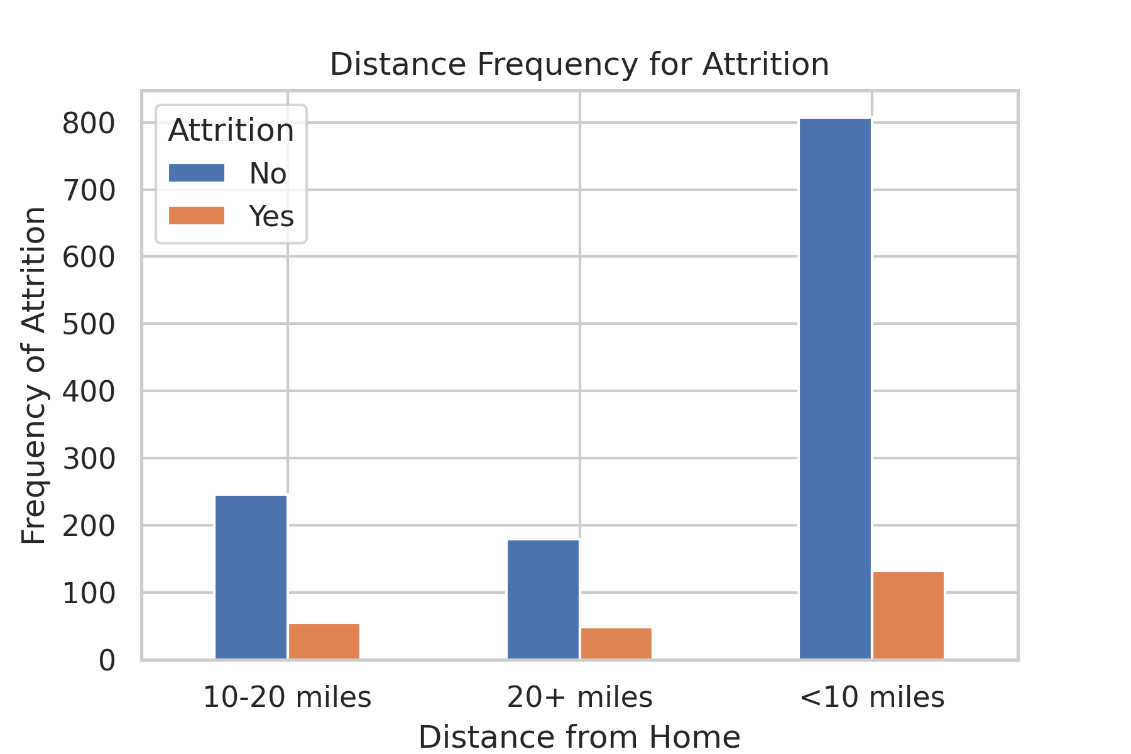
Is there a relationship between employee attrition and the distance they live from work?
Employees who live closer to work are less likely to leave for another job.

Slide 4
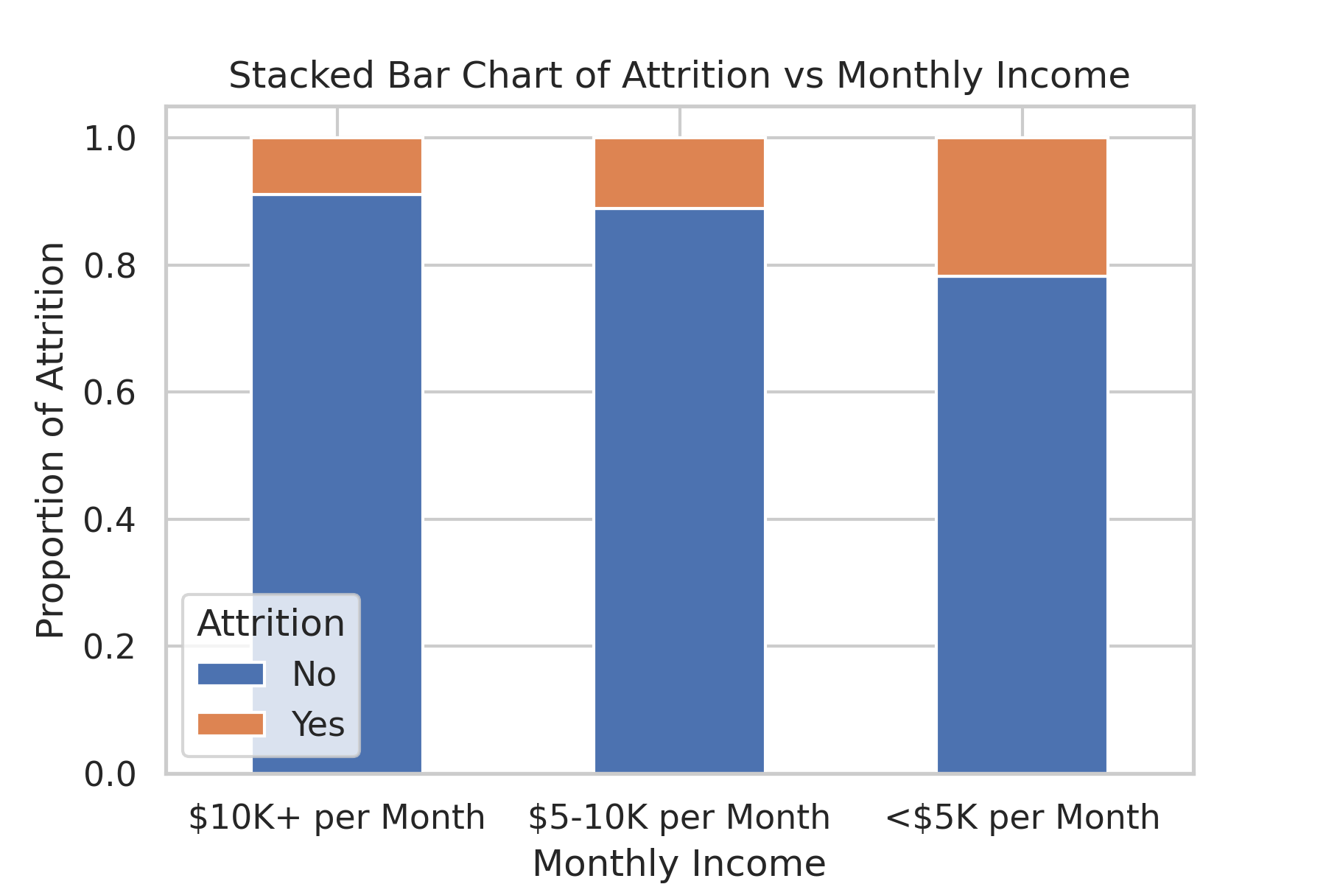
Is there a trend among income and attrition?
Monthly Income does seem to be a strong predictor on whether or not an employee leaves the company.

Slide 5
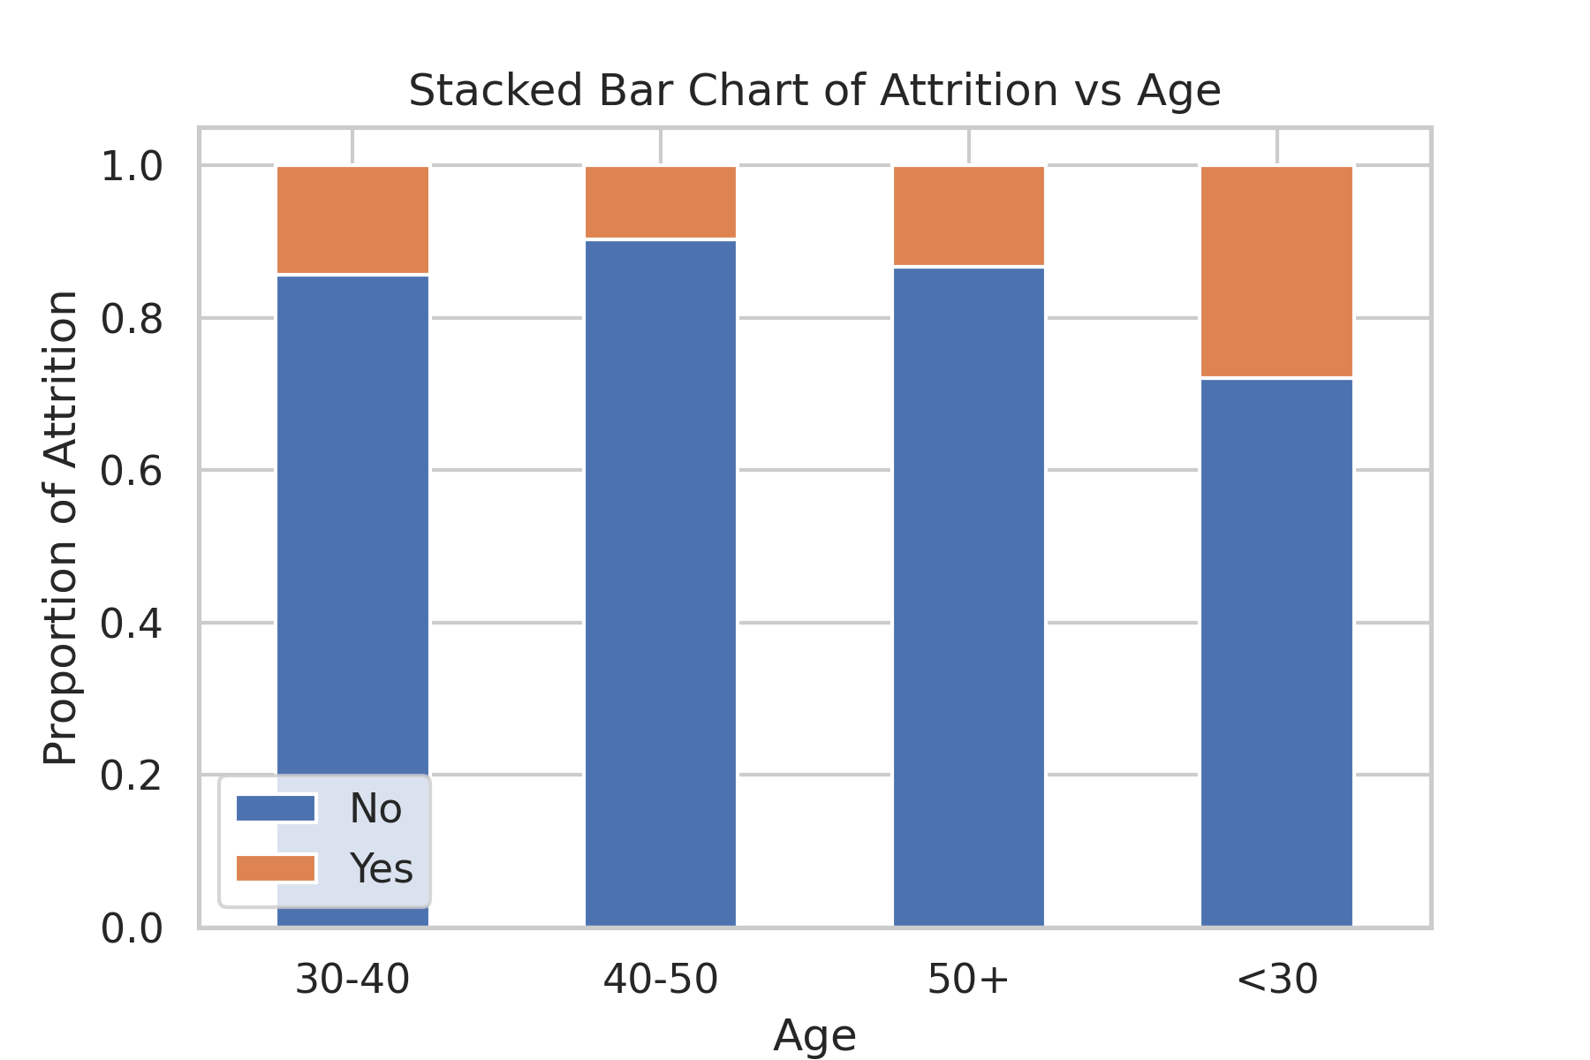
Is there a trend among age and attrition?
Younger employees are more likely to leave the company as compared to their older compadres.

Slide 6
What types of employees are at higher risk of attrition?
In Summary, the employee attrition is generally higher among:
Younger employees
Employees who are paid less
Employees who live the farther from work

Slide 7
Based on the data, what steps can HR take to minimize attrition?
HR can take the following steps to minimize attrition:
Create a thriving corporate culture, provide employee benefits, and provide opportunity for young employees to experience new opportunities
https://elearning.scranton.edu/resource/health-human-services/4-ways-companies-retain-young-workersO
Offer an equivalent salary - Offering a fair and equal compensation may not single-handedly guarantee employee loyalty, but offering salaries lower than the market will surely result in voluntary resignation, leading to staff attrition.
https://www.olxpeople.com/blog/ways-to-reduce-employee-attrition/
Flexible work has proven to have a significant impact on commute driven turnover. Consider offering four-day work weeks, flexible job starting times, subsidizing public transportation costs, and allowing remote work options.
https://www.tlnt.com/how-commute-issues-can-dramatically-impact-employee-retention/

